Slide 1
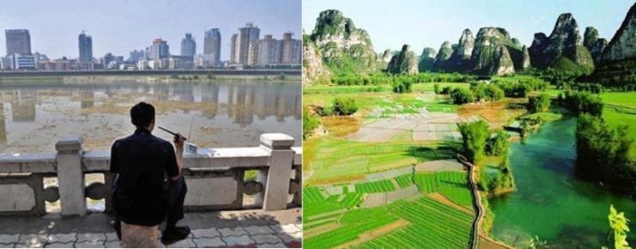
Environment Quality and Economic growth
Saket Pande

Slide 2
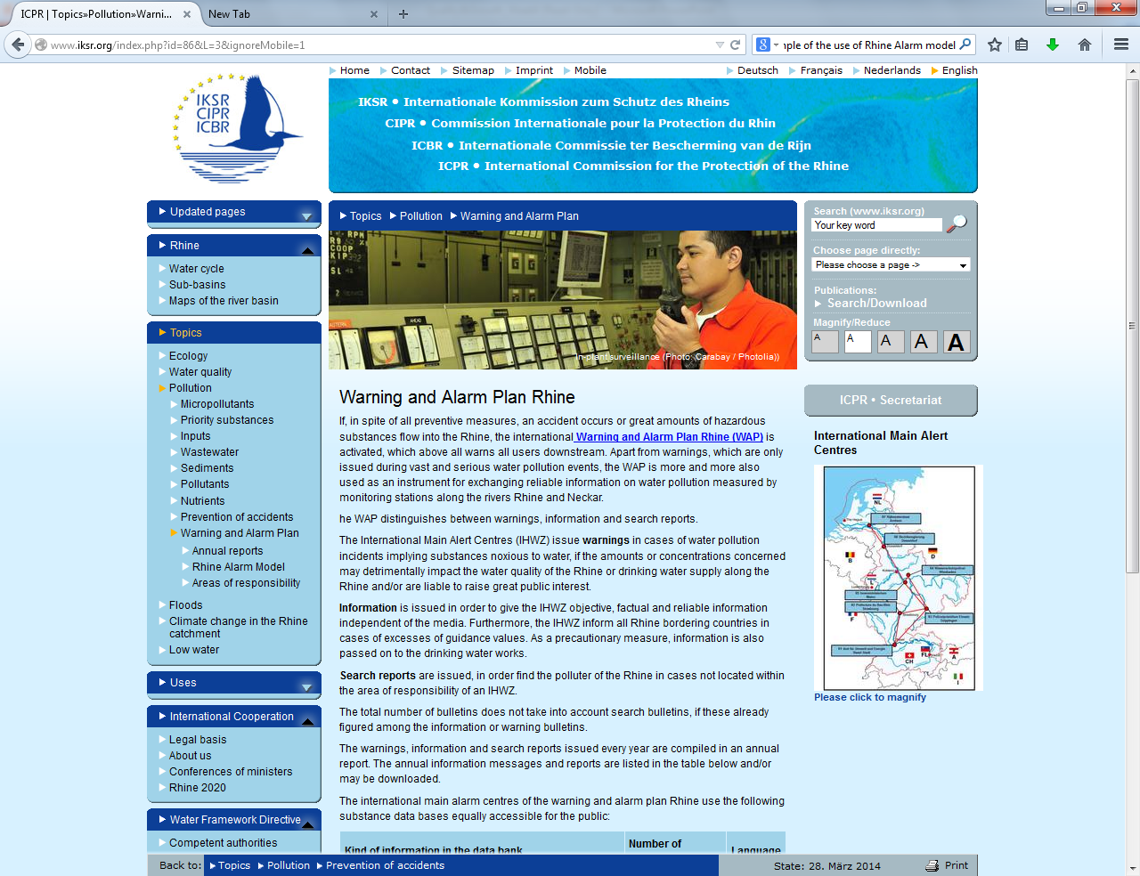
From the last week: Rhine Alarm model in action

Slide 3
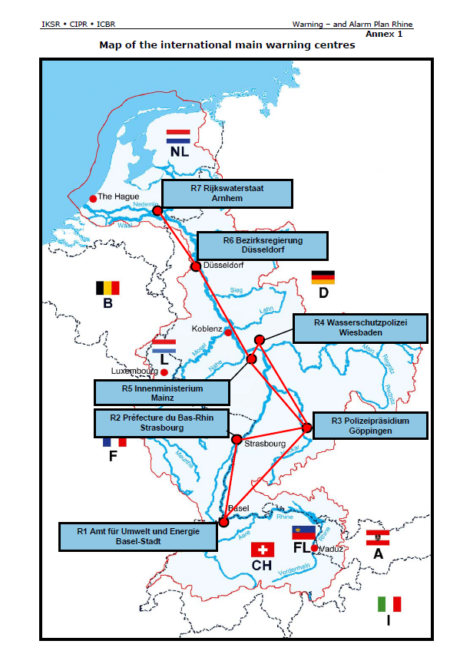
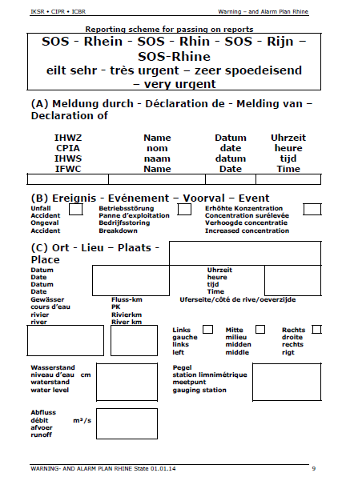

Slide 4
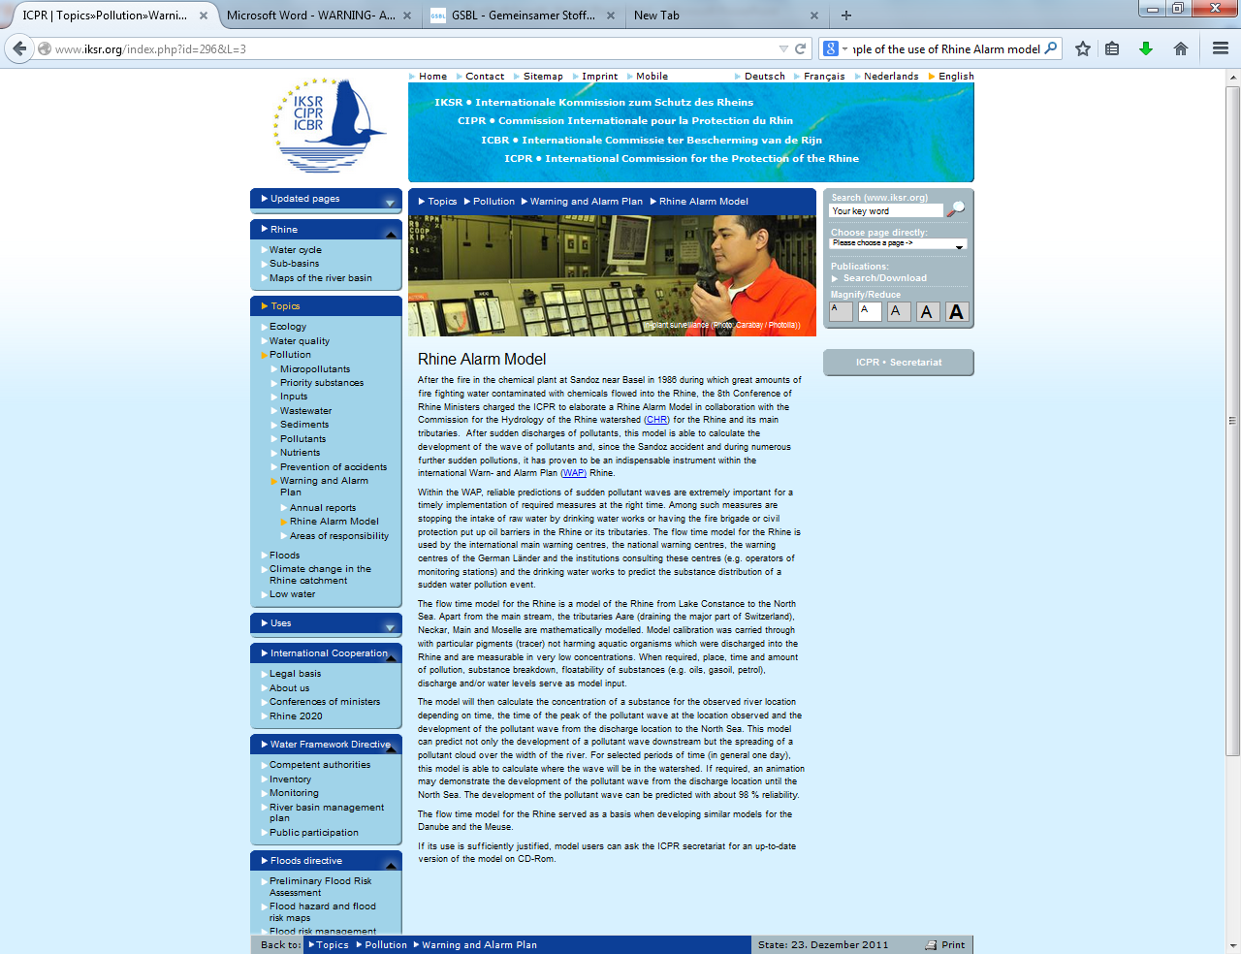

Slide 5
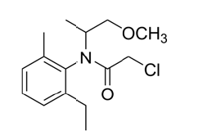
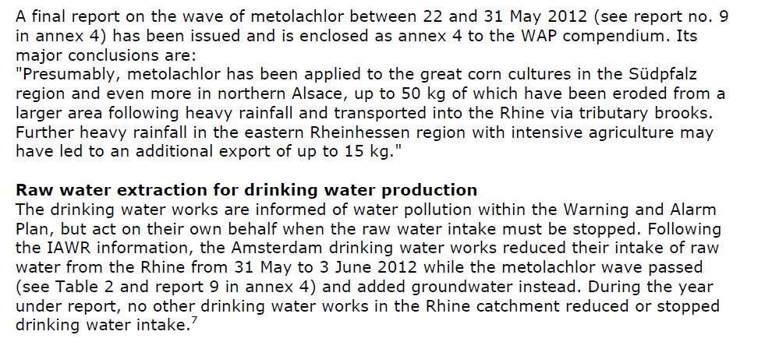
Metolachlor (weed killer) incident 2012

Slide 6
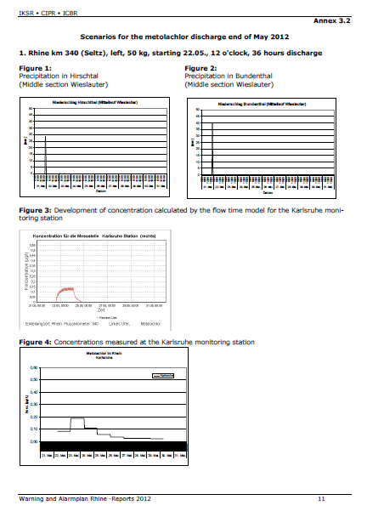
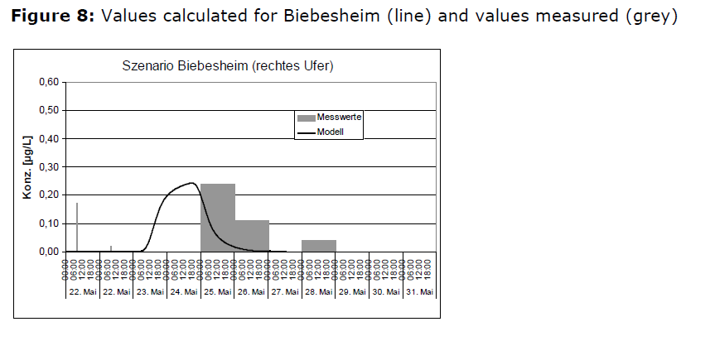

Slide 7
Begin Hour 1

Slide 8
What will we learn?
Constrained/unconstrained optimization
Why agents consume?-utility maximization
How producers produce?-profit maximization
How prices of goods appear?
Conceptualization of a society – overlapping generations model

Slide 9
What is development?
Development is about the well being of a society as a whole
Environment quality and economic growth are two aspects of it, both contribute to the wellbeing of a society
BUT economic growth may come at the cost of environmental quality

Slide 10
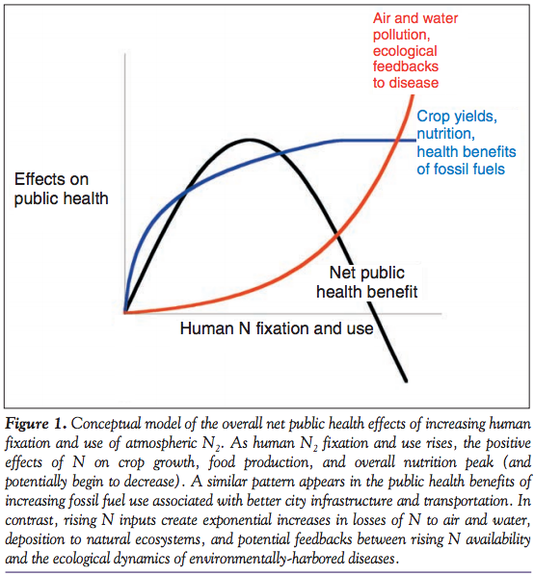
Why do we care?
This is a water quality modeling class!
We prefer better environmental quality but also better livelihood, more income or better economy. Often there is a tradeoff between them.
Source: onehealtheducation.blogspot.com

Slide 11

Rio Declaration on Environment and Development 1992
Principle 3: “The right to development must be fulfilled so as to equitably meet developmental and environmental needs of present and future generations.”

Slide 12
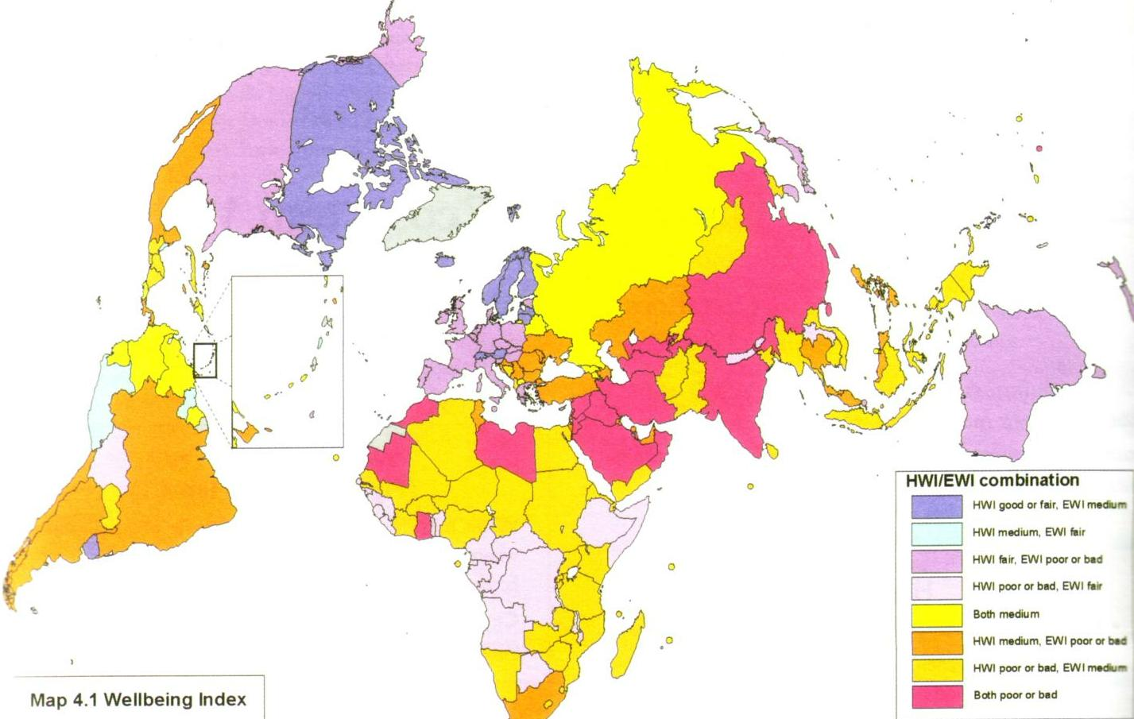
Source: www.geostrategis.com

Slide 13
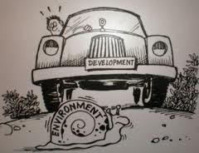
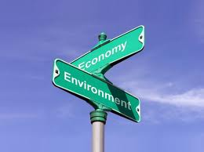
Is environment incompatible with development?
What do you think?

Slide 14
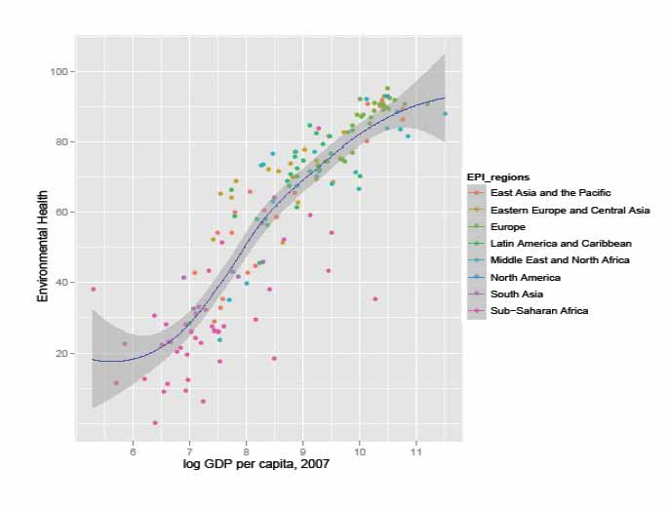
Development can lead to investment in environmental health
Source: environment.yale.edu

Slide 15
What do we need to explain this pattern of environment and growth?
How can we build low order models of economies or societies realistically?
Do we need models that determine how environment and economic growth shape each other as societies evolve over generations?
where scope for investment in environment and economic growth is possible?

Slide 16
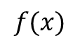
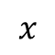
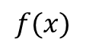
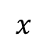
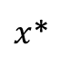
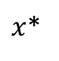
Unconstrained maximization
Maximization
Minimization
$$f(x)$$
$$f(x)$$
$x$*
$x$*
$$x$$
$$x$$

Slide 17
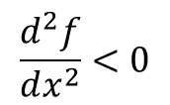
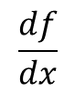
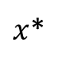
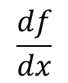
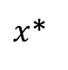
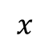
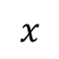
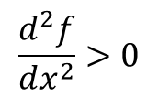
Unconstrained maximization
Maximization
Minimization
$$\frac{df}{dx}$$
$$\frac{df}{dx}$$
$x$*
$x$*
$$x$$
$$x$$
$$\frac{d^{2}f}{dx^{2}}<0$$
$$\frac{d^{2}f}{dx^{2}}>0$$

Slide 18
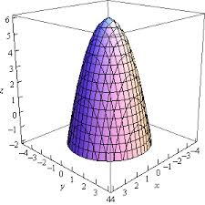
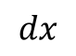
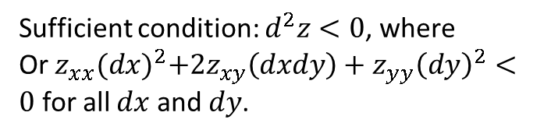
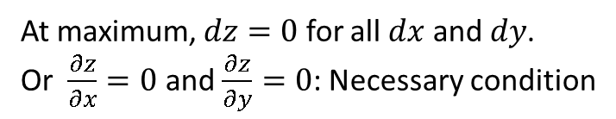
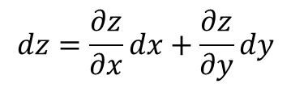
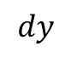
Unconstrained maximization of functions with 2 or more variables
$$dz=\frac{∂z}{∂x}dx+\frac{∂z}{∂y}dy$$
At maximum, $dz=0$ for all $dx$ and $dy$.
Or $\frac{∂z}{∂x}=0$ and $\frac{∂z}{∂y}=0$: Necessary condition
$$dy$$
$$dx$$
Sufficient condition: $d^{2}z<0$, where
Or $z_{xx}{(dx)}^{2}+{2z}_{xy}\left(dxdy\right)+z_{yy}{\left(dy\right)}^{2}<0$ for all $dx$ and $dy$.

Slide 19
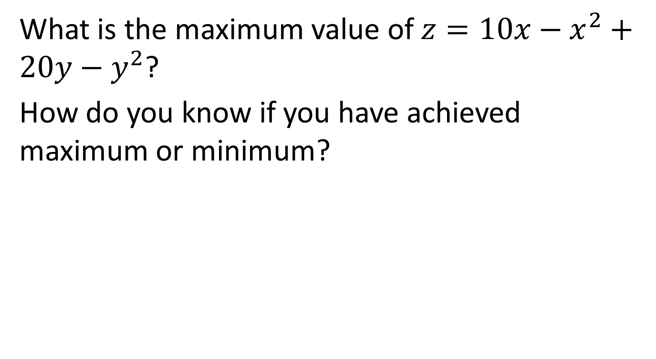
Exercise
What is the maximum value of $z=10x−x^{2}+20y−y^{2}$?
How do you know if you have achieved maximum or minimum?

Slide 20
Begin Hour 2

Slide 21
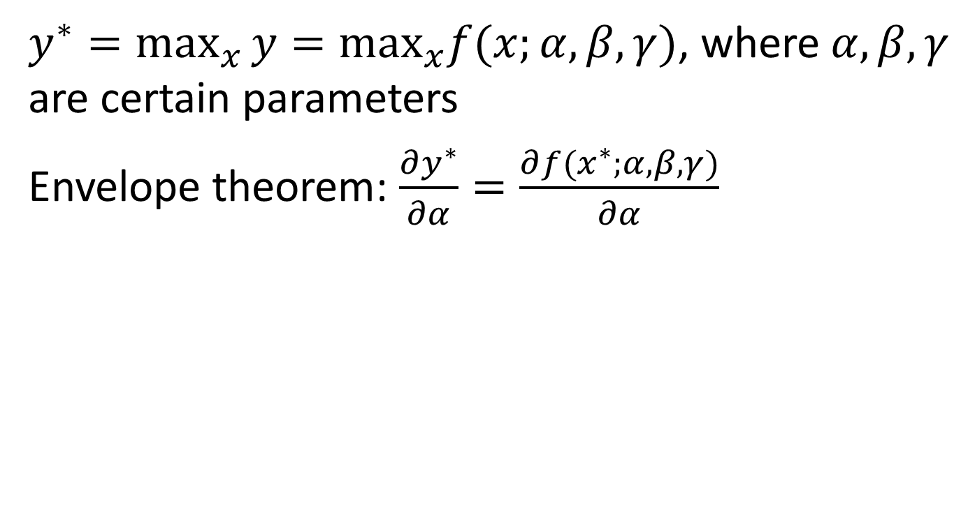
Envelope theorem
$y^{∗}=\max_{x}⁡y=\max_{x}f(x;α,β,γ)$, where $α,β,γ$ are certain parameters
Envelope theorem: $\frac{∂y^{∗}}{∂α}=\frac{∂{f(x}^{∗};α,β,γ)}{∂α}$

Slide 22
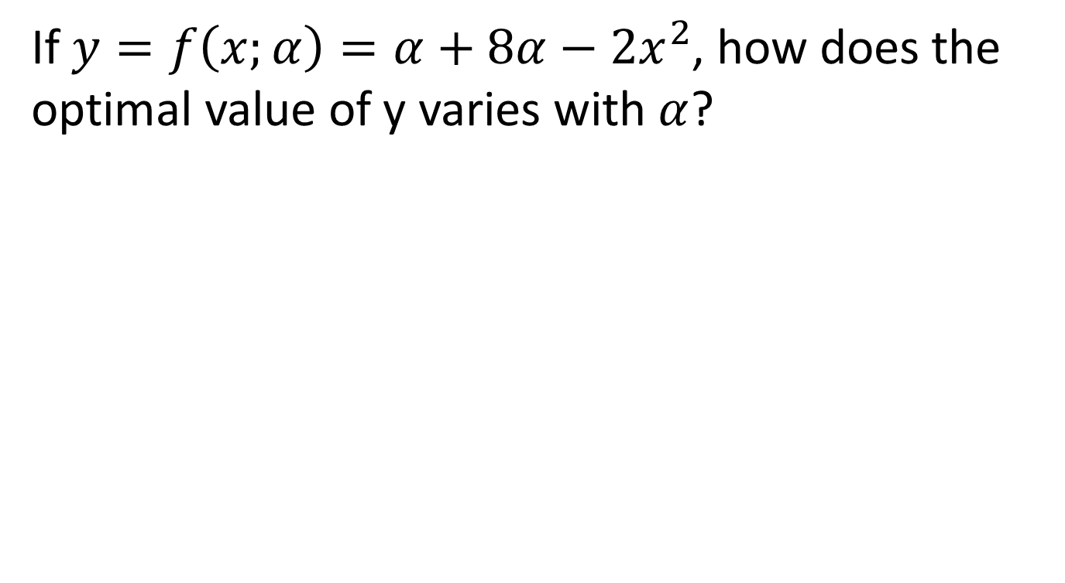
Exercise
If $y=f\left(x;α\right)=α+8α−2x^{2}$, how does the optimal value of y varies with $α$?

Slide 23
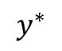
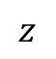
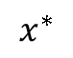
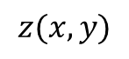
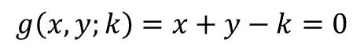
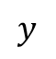
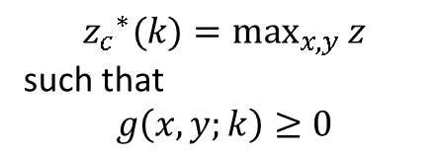
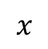
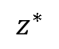
Constrained maximization
$$g\left(x,y;k\right)=x+y−k=0$$
$$y$$
$${z_{c}}_{}^{∗}(k)=\max_{x,y}{z}$$
such that
$$g\left(x,y;k\right)≥0$$
$$z$$
$$z(x,y)$$
$$z^{∗}$$
$$y^{∗}$$
$$x^{∗}$$
$$x$$

Slide 24
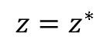
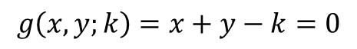
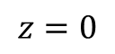
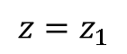
Condition of tangency
$$g\left(x,y;k\right)=x+y−k=0$$
$$y$$
$$z$$
$${z=z}^{∗}$$
$$z=z_{1}$$
$$y^{∗}$$
$$z=0$$
$$x^{∗}$$
$$x$$

Slide 25






Level sets
$$y$$
$$g\left(x,y;k\right)=x+y−k=0$$
$${z=z}^{∗}$$
$$z=z_{1}$$
$$z=0$$
$$x$$

Slide 26

Another way: the Lagrange method
The objective function is penalized for any deviation from the constraint function
Benefit: $z\left(x,y\right)$
Cost: $λg(x,y;k)$
Maximize net benefit (benefit - cost) where $λ$ (Lagrange multiplier) penalizes deviation from the constraint $g\left(x,y;k\right)=0$.

Slide 27

The Lagrange method
Consider a deviation of $Δk$, i.e. one is allowed to pick $x,y$ such that $g\left(x,y\right)=Δk$.
If $z(x,y)$ is maximized at $\tilde{x},\tilde{y}$ such that $g\left(\tilde{x},\tilde{y}\right)=Δk$, then what should be the value of $λ$?
$λ=\frac{∂{z_{c}}_{}^{∗}(k)}{∂k}$: the Lagrange multiplier measure how z changes per unit deviation from the constraint
Group work:

Slide 28



The Lagrangian
$${z_{c}}_{}^{∗}(k)=\max_{x,y}{z}$$
such that
$$g\left(x,y;k\right)≥0$$
$$→$$
If $ℒ\left(x,y,λ;k\right)=z−λg\left(x,y;k\right)$ then
$${z_{c}}_{}^{∗}(k)=\max_{x,y,λ}{ℒ\left(x,y,λ;k\right)}$$

Slide 29

Assignment
Show that $λ=\frac{∂{z_{c}}_{}^{∗}(k)}{∂k}$ based on Envelope theorem for constraints of type: $g\left(x,y;k\right)=f\left(x,y\right)−k≥0$.

Slide 30
Begin Hour 3

Slide 31
Axioms for consumer preference theory

Slide 32
Utility function
Preference for more consumption
Preference for more consumption declines as more is consumed
Preference ‘measured’ by a utility function such that:
Individual makes (consumption) choices that maximize his utility
Utility maximization ensures her chosen consumption is preferred over all other possibilities

Slide 33

Utility function

Slide 34
For 2D

Slide 35




Utility maximization is constrained by income: c₁ is available at price p₁ and c₂ is available at price p₂
c₂
$U\left(c_{1},c_{2}\right)=7$ utils
$${p_{1}c}_{1}+p_{2}c_{2}=M+∆M$$
$${(c_{1}}^{∗},{c_{2}}^{∗})$$
(household budget)
$${p_{1}c}_{1}+p_{2}c_{2}=M$$
c₁

Slide 36

How is income, M, earned?
Wage ($w$)
Labor participation in some production activity
Returns on investments ($r$)
Capital participation in some production activity
Production activity: input of labor $ℓ$ and capital $k$produces (outputs) a good $y$
Wage and return on investments depend on the value of good produced
Production function, $y=f(ℓ,k)$: amount of good ($y$) produced as a function of capital $k$and labor $ℓ$input

Slide 37



A production function: producing beer or bitterballen
$$k$$
$$f\left(ℓ,k\right)=0.6 units$$
$$ℓ$$

Slide 38

How is income decided?
For given prices of labor (wage $w$), capital (return of capital $r$) and good being produced ($p$),
a ‘producer’ ‘demands’ the amount of labor $ℓ^{∗}$ and capital $k^{∗}$ and produces an amount $y$ such that her profits are maximized
Then
Income from labor = $wℓ^{∗}$
Income from investment = $(1+r)k^{∗}$

Slide 39







Profit maximization: $\max_{ℓ} pf\left(ℓ\right)−wℓ$ for given prices $p$ and $w$
$$w/p$$
$$y=f(ℓ)$$
$y$*
Real Income from labor=
(normalized by output price)
$\frac{w}{p}ℓ$*
Total production
profit of the producer (normalized by output price)
$ℓ$*
$$ℓ$$

Slide 40
End of hour 3

Slide 41

Where do the prices $w,r and p$ come from?
economy at equilibrium
Prices are such that respective markets (or supply balances the demand for beer and bitterballen) clear
Consumers and producers agree on the price and quantity of commodities
Consumers maximize their utilities at those prices and quantities
Producers maximize their profits at those prices and quantities

Slide 42

Socio-economy
p
producer
consumer
w, r
Socio-economy

Slide 43

Production of two goods
$$x=x\left(k_{x},ℓ_{x}\right), y=y(k_{y},ℓ_{y})$$
given that there is limited amount of capital and labor,
$$k_{x}+k_{y}=\overline{K}$$
$$ℓ_{x}+ℓ_{y}=\overline{L}$$

Slide 44
















Production Edgeworth box and the efficient production set
$$ℓ_{y}$$
$$y$$
$$x_{4}$$
$$x_{3}$$
$$x_{2}$$
Efficient production set
$$\overline{K}$$
$$k_{x}$$
$$x_{1}$$
$$y_{1}$$
Slope = -w/r = implicit price ratio of labor to capital
$$k_{y}$$
(Capital)
$$y_{2}$$
$$y_{3}$$
$$y_{4}$$
$$x$$
$$ℓ_{x}$$
$$\overline{L}$$
(Labor)

Slide 45
Efficient allocation of inputs and efficient production set
Efficient allocation of inputs: an allocation of inputs to the production of outputs such that it is not possible to produce more of one good without producing less of another
Efficient production set: set of efficient allocation of inputs for all possible level of outputs

Slide 46









Production possibility frontier
All efficient combinations of $x$ and $y$ that an economy can produce given its resources and technology
$$y$$
Production combinations corresponding to efficient allocation of inputs along the efficient production set
$$y_{4}$$
$$y_{3}$$
$$y_{2}$$
$$x_{1}$$
$$x_{2}$$
$$x_{3}$$
$$x$$

Slide 47

How to obtain production possibility frontier mathematically?
Problem formulation: maximize production of one good such subject to constraints that the production of the second good is at a certain level and availability of inputs is limited (balance)
$$\max{x(k_{x},ℓ_{x})}$$
s.t. $\overline{y}=y\left(k_{y},ℓ_{y}\right)$
$$k_{x}+k_{y}=\overline{K}$$
$$ℓ_{x}+ℓ_{y}=\overline{L}$$

Slide 48

Production possibility frontier: An example
Solve the problem of estimating the production possibility frontier for $x\left(k_{x},ℓ_{x}\right)= {\left(k_{x}\right)}^{\frac{1}{2}}{(ℓ_{x})}^{1/2}$and $y\left(k_{y},ℓ_{y}\right)= {\left(k_{y}\right)}^{\frac{1}{2}}{(ℓ_{y})}^{1/2}$

Slide 49
General Equilibrium 1.0: Robinson Crusoe economy
Robinson is stuck on an island (a closed society). He derives his wellbeing from coconuts and fish (society derives its utility from two goods). However, he himself has to spend his labor and physical capital to gather coconut and hunt fish (society has to produce the goods that it consumes based on limited availability of capital, labor and technology). What level of well being can he achieve ? (what level of development can society achieve?)

Slide 50



General equilibrium 1.0: Emergence of prices, efficient production and utility maximization
Production possibility frontier F(x,y)=0
U(x,y): derived wellbeing
$y$(fish)
Slope = ratio of price of coconuts to fish = $p_{x}/p_{y}$
$x$(coconuts)

Slide 51

General Equilibrium 1.0: Problem formulation
$$\max{U(x,y)}$$
s.t. $F\left(x,y\right)=0$
Assignment: Solve for equilibrium allocation and prices for $\overline{K}$ = 100 and $\overline{L}=400$

